Slide 1
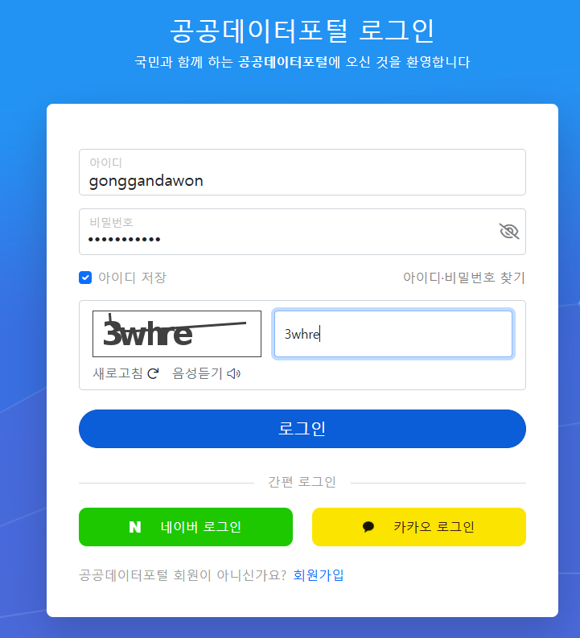
비밀번호
DooSan1403@

Slide 2
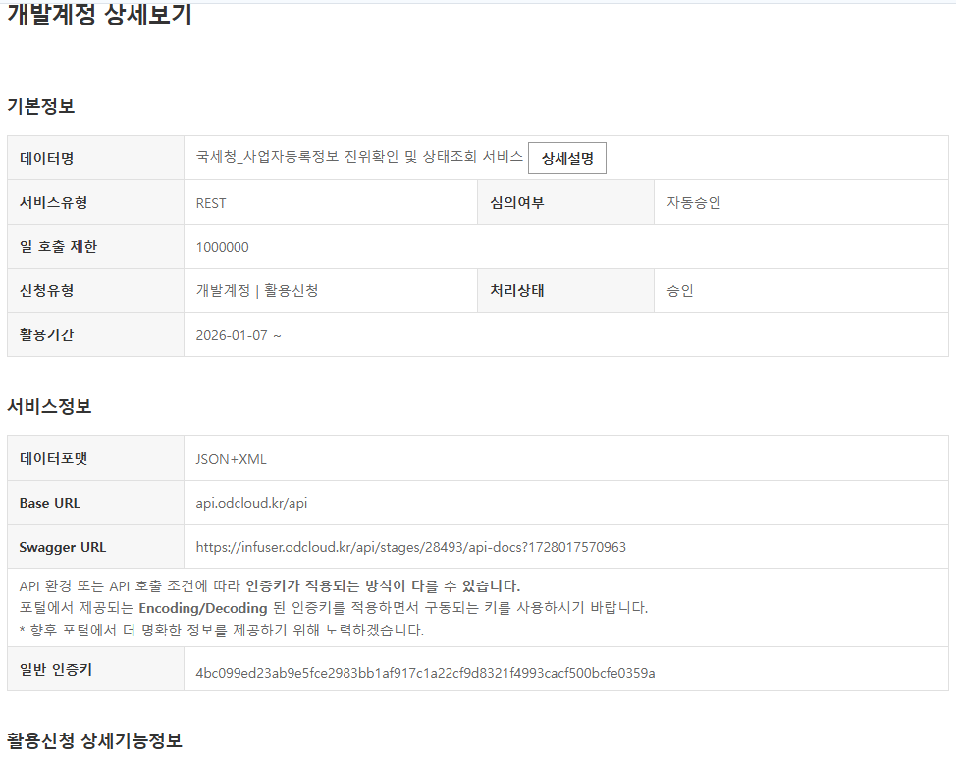
Base URL : api.odcloud.kr/api
Swagger URL : https://infuser.odcloud.kr/api/stages/28493/api-docs?1728017570963
일반 인증키: 4bc099ed23ab9e5fce2983bb1af917c1a22cf9d8321f4993cacf500bcfe0359a

